Slide 1
Beaker
Christian Klein, Derek Yu, Zifeng Jiang, Joseph Thill, Jay Patel
COMS 362
Group 2
Notes:
Christian
Hello, I am Christian Klein of Group 2; here with Joe, Derek, Zifeng and Jay to describe our experiences with Beaker throughout the semester for Computer Science 362, Object-Oriented Analysis and Design.

Slide 2
Overview
What is Beaker?
Use Cases
Domain Model
Object-Oriented Design
Design-To-Code Traceability
Design Strategies
Design Evolution
Notes:
Christian
In this presentation, we will explain what exactly Beaker is, dig into the use cases that we wrote up, display the domain model that we created, reveal our initial object-oriented design approach to the class diagram, explain the changes made to that diagram in terms of design-to-code traceability, go over the design strategies of Beaker, and finish up with Beaker’s design evolution.

Slide 3

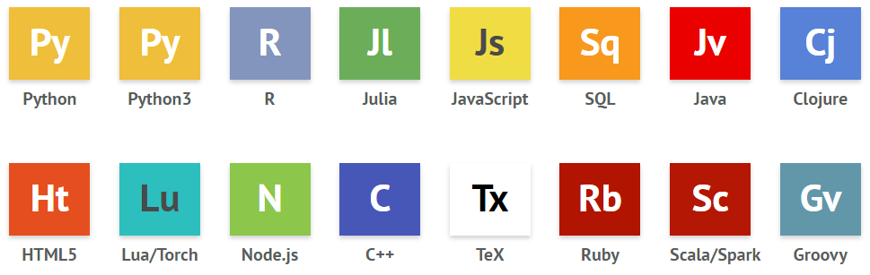

What is Beaker?
Notebook-style multi-language environment
Developed by TwoSigma
Open source
Notes:
Studio 1 - Christian
So what is Beaker?
Beaker is a notebook-style multi-language environment that allows users to analyze, visualize, and document data. The initial release that our team examined is from October 2015. Beaker is available in both application and web form. Beaker’s extensive list of supported languages is shown below. As you can see, they currently support 16+ languages which includes many of the standard languages used in industry, such as Java, Python, and C++. Beaker is developed by TwoSigma, a team with multiple other projects written mostly in javascript. Beaker is also open-source, and available for anyone to view or download on github.

Slide 4
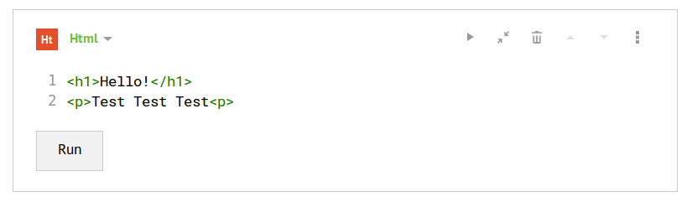
What is Beaker?
One Notebook is comprised of multiple language cells
Run all or individual cells for visual results
Notes:
Studio 1 - Christian
When running Beaker, the user creates notebooks, similar to creating a new document in Microsoft word. This notebook document then holds as few or as many cells as the user wishes. These cells are text containers that may consist of code, plaintext, or act as a section divider. If a cell is holding code, the user may run it individually or along with all other code cells. Keep in mind that each cell may be a different coding language. The idea behind this multi-language paradigm is to allow for each aspect of any problem being solved by the notebook to be done so using the best possible language. The output of Beaker, then, is a published notebook that anyone can download and run. With that in mind, Beaker is not meant for the creation of a brand new product, but rather to facilitate solutions to new problems.
As you can see here, we have a Beaker HTML cell with some simple code written within. Clicking the run button below the code executes the cell and displays the plaintext result. On the top right of the cell are other options, such as expanding the cell, deleting the cell, and shifting the cell up and down the notebook. This intuitive, visual design creates a very user-friendly experience and allows for forgiving development.

Slide 5
Use Cases
New Cell
New Previous Cell
Run Cell
Run All Cells
Delete Cell
New Textbox
New Section
Create New Empty Notebook
Save Notebook
Upload File
Open Javascript Tutorial
Switch to Advanced View
Report Bug
Publish
Notes:
Studio 3 - Christian
In studio 3, our group was responsible for generating use cases for some of Beaker’s functionality. We created a Linux virtual machine to run Beaker and examine its behavior. This forced us to tinker with Beaker’s functionality and learn what exactly the user experience entails. Shown here are the 14 use cases that we came up with. The number is semi-arbitrary; we had 5 group members and we each did around 3 cases based on complexity. In an industry setting, it is very likely that ALL use cases would be covered. Since we could not feasibly cover every case, our team was very deliberate in selecting most, if not all, of the core functionality such as creating a new cell and running a cell while also including a few non-functional features, such as reporting bugs and publishing notebooks. Overall, it was an entertaining experience to attempt to find all the paths a single feature can lead down.

Slide 6
Use Cases: Example
Use Case Name: New Cell Actor: Users Goal: The user wishes to switch from one language to another. Preconditions: User needs to open Beaker application and then open either an empty notebook or a previously opened one. Main Flow: 1. Select the dropdown that says, “Code”. 2. Beaker will give the options to select languages, if the user do not see the language that they wish, select the option where
it says “Other languages”. 3. Select the radio button for the language the user wish to use. 4. Hit “Close”. 5. Beaker will then give a textbox where the user can enter the code for that particular language. 6. If the user wish to switch the language then user can click on the trash button to delete the textbox and then select the
language; follow step #2.
Alternate Scenario: Trigger Condition: Beaker usually has two languages that are already pre selected for you, but the user can select any other
language that are provided by Beaker. Alternate Scenario Steps: 1. After opening an empty textbox, user can select a any new language by using the down arrow “↓”.
Notes:
Studio 3 - Christian
Here is an example use case that we wrote up; this one being for creating a new cell. No sense in trying to read all the text, but I’ll go over some key aspects.
A single use case consists of an actor, or the entity performing the action, the goal of the use case, the preconditions assumed before the use case occurs, the main flow of actions to achieve the goal, and, if applicable, the alternate scenarios that could possibly take place during the use case. In industry, use cases are very helpful for 2 major reasons: 1 - making sure the clients are receiving the experience that they want from their application, and 2 - making sure that the developers are implementing the correct action-flow. In our situation, where the application was already implemented, generating the use cases was trivial, as it was just a matter of performing and documenting our actions.

Slide 7
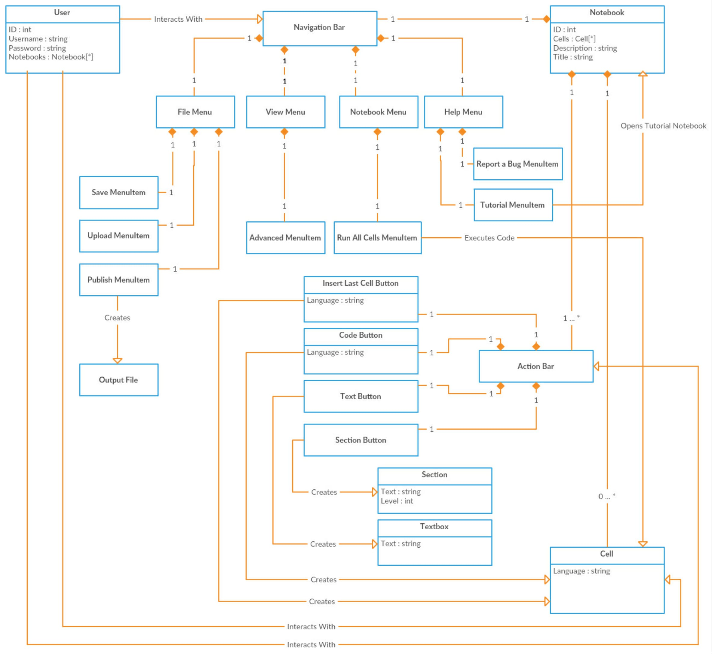
Domain Model
Shows behaviour and data relationships
Utilized nouns/phrases technique
Sometimes difficult to identify attributes
Notes:
Studio 4 - Derek

Slide 8
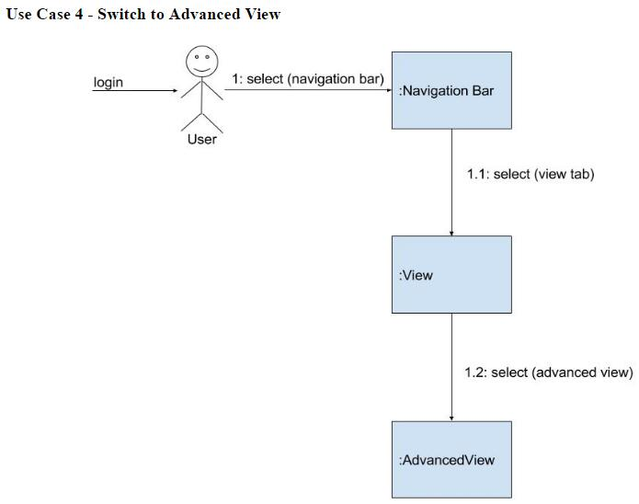
Object-Oriented Design: Communication Diagrams
A kind of UML interaction diagram
Focuses on object interactions
Notes:
Studio 6 - Zifeng

Slide 9
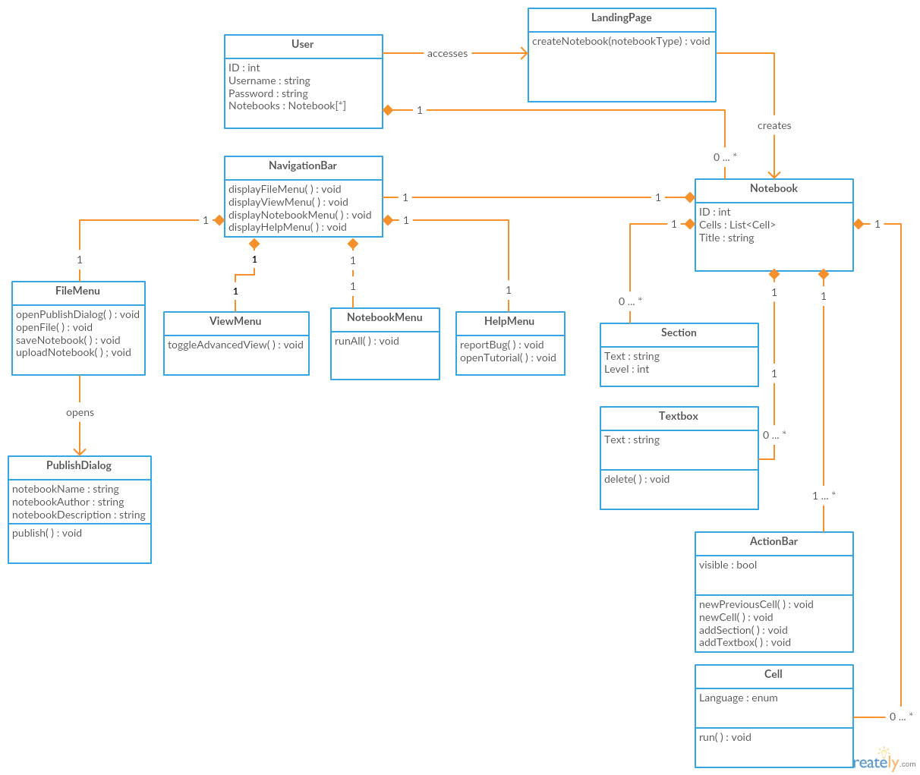
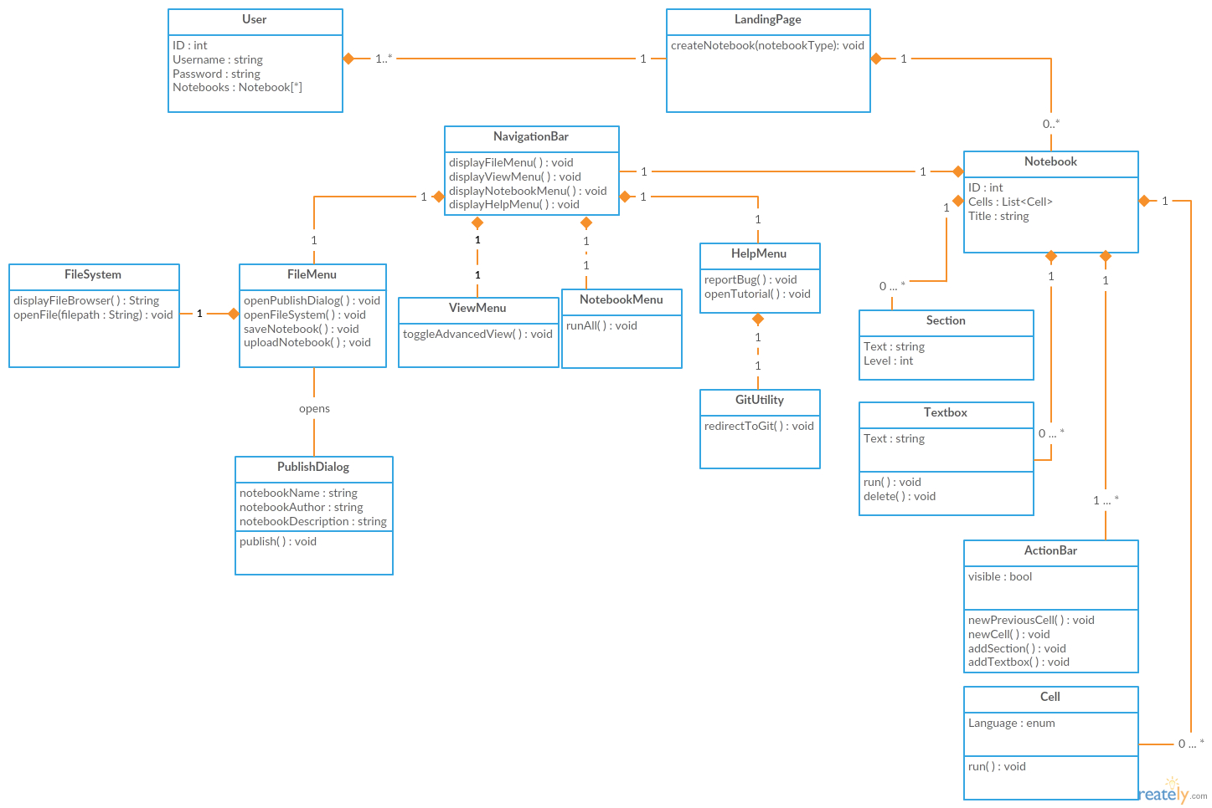
Object-Oriented Design: Class Diagram
Notes:
Studio 6 - Zifeng

Slide 10
Object-Oriented Design: Class Diagram
One UML diagram that showing the system’s classes, attributes, operations and relationships between objects
Corresponds to our use cases and communication diagrams
Notes:
Studio 6 - Zifeng

Slide 11
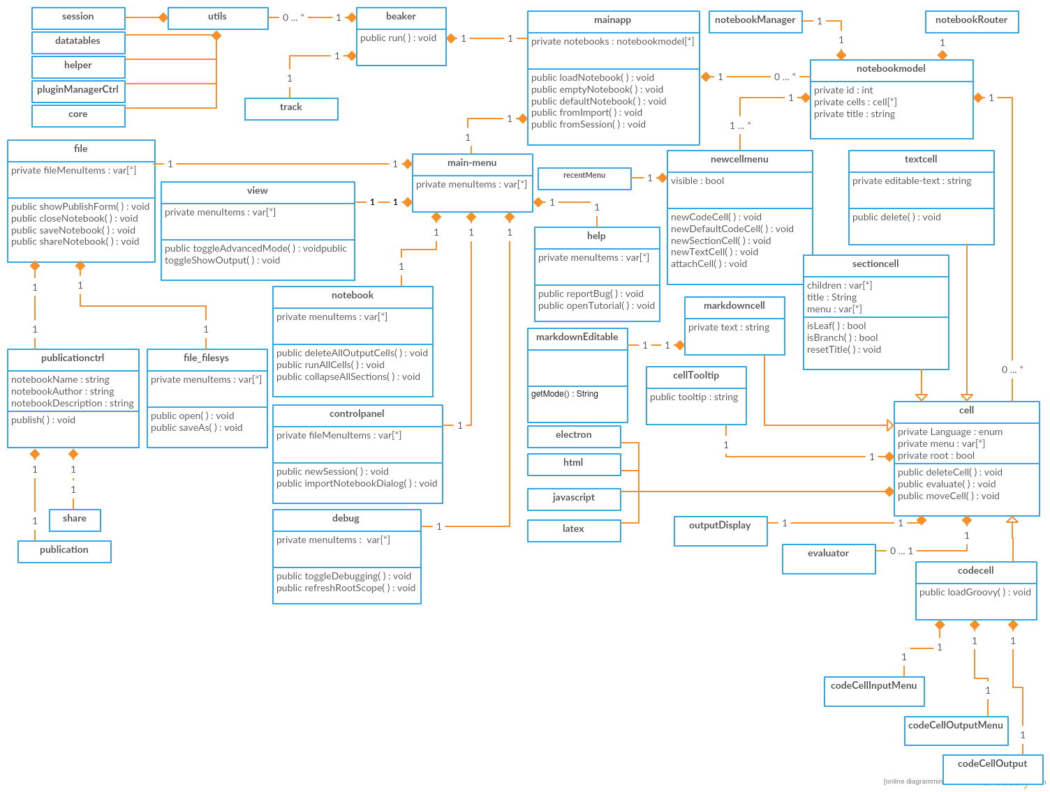
Design-To-Code Study
Beaker had more classes than our initial, simplified design
Actual implementation broke our classes into multiple, smaller classes
Ex: Our initial Cell class was implemented by 10+ classes
Notes:
Studio 9 & 10 - Derek Yu

Slide 12
Design-To-Code Study: Challenges
Difficult to identify classes because of Beaker’s sheer size
Lack of thoroughly understanding Beaker caused us to miss classes
Recommended plugins issues
Notes:
Derek

Slide 13
Design Strategies Study
Analysis of the design patterns used to enhance the program and its development
Anti-patterns that surfaced in the process of development
Overall, Beaker is uses design patterns often, while minimizing anti-patterns
Notes:
I’m Joe Thill, and I will be discussing Studio 11, the Design Strategies study. This was an analysis of design patterns and anti patterns used in the Beaker software.
Design patterns are various methods of design and implementation that enhance the performance, structure, and readability of the program. While more of these isn’t necessarily better, software want to implement good design patterns wherever they can, as it makes future development and design easier, as well as debugging.
Anti patterns, as the name implies, are patterns that occur in code that make it more difficult to maintain and debug the software system. They often occur due to lack of developer experience, poor design decisions, and sometimes just over a long period of time.
What we found is that Beaker is tasteful in its use of design patterns, and have almost no occurrences of anti patterns.

Slide 14
Design Strategies Study: Design Patterns
Pattern Name | Example Location | Description
Abstract Factory | plugin/jvm/src/main/java/com/ twosigma/beaker/jvm/updater | Many uses of factory patterns throughout Beaker. Seems to be primary creational pattern used.
Singleton | /core/src/main/web/app/beaker.js | The beaker class represents the core of the program, so only one version needs to exist at any given time.
State | beaker-notebook/core/src/main/web/app/mainapp/components/notebook/cell-directive.js | The cells in Beaker use states to represent the language used, and whether it is locked.
Observer | \core\src\main\web\app\mainapp Line 1127 | Event handler called keydownHandler, which observes/ listens for key presses in order to handle input
Memento | beaker-notebook/core/src/main/web/app/mainapp/components/notebook/cell-directive.js Line 89 | Beaker uses the last language used in a cell, and then uses that language when creating new cells
Notes:
First I will go over many of the design patterns used by Beaker.
Factories are a large part of Beaker, both in the form of Abstract Factories and Factory methods. For example, there are a series of Factory Java classes to create various Updater classes. The UpdaterFactory class is the abstract factory class used to create objects extended from the Updater abstract class. The concrete classes that extend these classes are ObservableUpdaterFactory and BeakerDashboardUpdaterFactory, which each make their own concrete objects.
Singleton is useful in terms of the main core of the program, the beaker class. There is only one Beaker program running at any given time, so ensuring only one object is used and made prevents some bugs and headache later on.
The State design pattern is used in the cell objects in representing Beaker cells. They use states to represent the language used in that particular cell, as well as showing whether that cell is locked. If the state is locked, then the cell has limited interaction and options available.
Observer pattern is used by a keyboard handler class, as it listens for keyboard input, and once a key is pressed or interacted with, the class handles proper program response to handle that input.
The Memento pattern is also used in the cell design. It is used to keep track of the last language used for a cell in the notebook, and then when the user creates another cell, the new cell defaults to that saved language.

Slide 15
Design Strategies Study: Design Patterns cont.
Pattern Name | Example Location | Description
Chain of Responsibility | shared\src\main\java\com\twosigma\beaker\shared\module\util\GeneralUtilsImpl.java | GeneralUtilsImpl.java has a set of file system methods which handle four different file formats. Depending on the file format, the responsibility gets passed toward the correct method, either a Path, File, String, or URL.
Command | /core/twosigma/beaker/core/module/elfinder/impl/commands | Many command classes in the folder, all implementing the Command pattern.
Interpreter | \plugin\cpp\src\main\java\com\twosigma\beaker\cpp\utils\Extractor.java | Extractor extends the base class CPP14BaseListener and expands on grammar parsing logic.
Prototype | \core\src\main\web\app\mainapp Line 1229 | Keyword “.this” is used for prototype design pattern.In Beaker they use “.this” in many places where they are specifically calling the one that was declared in the constructor.
Builder | Does not exist within Beaker | Creation of objects doesn’t require a granular design pattern like builder to create them. Beaker mainly relies on factories to create objects.
Notes:
Next is chain of responsibility, which is used in the GeneralUtilsImpl class. It has several methods for interacting with the file system, including four different file formats. Depending on which file format is used, the program will pass the responsibility down to the correct method for that file format, either Path, File, String, or URL.
There are plenty of command classes in a folder in Beaker. All of them implement Command class and represent different functions. However, each of the functions is packaged in one specific class to apply Command design pattern.
Interpreter is used a bit in Beaker. The Extractor class extends the base class CPP14BaseListener and expands on grammar parsing logic for the C++ language.
Prototype occurs in the mainapp file in Beaker as well. Keyword “.this” is used for prototype design pattern. In Beaker they use “.this” in many places where they are specifically calling the one that was declared in the constructor.
I’ll also go over a design pattern that didn’t occur in Beaker, the Builder pattern. They didn’t seem to use this pattern, likely as the advantages of the builder pattern weren’t needed in Beaker object. Object creation was mostly handled by Factory objects and methods. This shows that the Beaker developers aren’t just implementing as many design patterns as possible, they just implement the ones that are useful for their needs.
There are many other design patterns that are both used and not used in Beaker, but these are the important and high-impact design patterns used in Beaker.

Slide 16
Anti Patterns
The Blob
Doesn’t occur. Split into views, service, and backend, demonstrating separation of concerns
Lava Flow
Doesn’t occur. The majority of Beaker’s code is well documented and modular, project still early
Functional Decomposition
Doesn’t occur. All classes are objects with specific purposes, such as Serializer and Updater
Poltergeists
Occurs at core/src/main/web/app/mainapp/components/pluginmanager/pluginmanager.js
Notes:
Now we will discuss many potential anti patterns in software, and find if they occur in Beaker. If they don’t, we’ll discuss why this is likely the case, and if they do, we’ll say what class or classes are responsible.
The blob occurs when a majority of responsibilities is contained within a single, “god” class. This class contains a bulk of attributes and/or methods that other classes need to function. This forces these other classes to have multiple dependencies with the blob, transforming them into simple, redundant, data classes. Beaker is not a victim of The Blob pattern.This anti pattern has been avoided within Beaker by dividing key functionality into layers. The developers split the layers into views, service, and backend which demonstrates separation of concerns.
Lava Flow is the existence of old, poorly documented code that often appears spaghetti-like, but no one on the development team is quite sure what it does or how to deal with it. This typically occurs on products that began as research or proof-of-concepts that eventually became full projects. Beaker is not a victim of Lava Flow. The majority of Beaker’s code is well documented and modular. Since the version of Beaker being examined is still in-progress, there may not have been much opportunity for Lava Flow to even begin.
Functional decomposition occurs when classes are designed and related in terms of functions and subroutines instead of class hierarchies and their relationships. Instead of having a class have both attributes and several operations to interact with other classes in the system, a class would simply have one or few functions that it runs with entirely private members. It doesn’t use the advantages of an object-oriented design and only runs a particular subroutine. Beaker has no occurrences of Functional Decomposition.
All classes are named and defined as objects with specific purposes, such as Serializer, Updater, and their subclasses. It seems like they were careful when defining classes to ensure that each class not only contributes to the class hierarchy, but also always has both attributes and operations that serve its particular function or role in the program. No class seems able to be simply moved as a function into another class, which is a good sign that Functional Decomposition isn’t occurring.
Poltergeists are classes within a system that have little to no functionality and an extremely short lifespan. These classes offer miniscule purpose and often clutter the software system or attempt to over-abstract things, thus creating a less-than-ideal product. This usually occurs when a developer is new to object-oriented programming. An occurrence of poltergeists is found within Beaker. Since the Beaker version we are looking at is in-progress, it’s tough to say whether or not these “poltergeists” are due to poor programming or are placeholders for future code, but an example poltergeist in the current code is pluginmanager.js class. This class is empty at the moment and has no methods.

Slide 17
Anti Patterns
Golden Hammer
Doesn’t occur. The MVC structure leads to every class being purposeful and efficient.
Spaghetti Code
Doesn’t occur. The developers make sure to not cite too many methods in small structure.
Cut-and-Paste Programming
Doesn’t occur. They use common functions that are called to avoid copy and pasting.
Overall, very few occurrences of anti patterns.
Notes:
Golden Hammer means that the developer uses inappropriate and inefficient methods to solve problem. Maybe the developer is really familiar with one specific pattern so that he can apply it on many different programs. However, the inappropriate and inefficient method increases the potential risk of these programs. Which means that choosing the proper tool to solve corresponding problems is important during development process. Golden Hammer doesn’t appear in Beaker.
In fact, as the popular object-oriented programming pattern, the MVC structure is appropriate to be the main pattern of Beaker. This pattern leads every classes to be purposive and efficient. So the developer can use proper pattern in every part of Beaker.
Spaghetti Code means that one small method includes a complex control structure. For instance, the control structure contains many “if” and “goto”. This complex pattern makes the code hard to understand and edit. It doesn’t separate one big function into many small components successfully. Beaker doesn’t include Spaghetti Code. Spaghetti Code is an usual mistake for beginner. But it is easy to avoid in any proven program. The developers just make sure that not solving one complete puzzle in only and not citing too many methods in small structure.
Cut-and-paste programming usually means that there is a chunk of code that is being copied and pasted at bunch of places in order to do some functionality. But this does not mean that your code is effective because if there is an error in a code that you copied from somewhere and pasted in your program you will still have that error in your code which then later results into difficult to fix code of a particular mistake. Cut-and-Paste Programming is not found in Beaker. This anti pattern has been avoided within Beaker by calling the function instead of copying and pasting same lines of code.
Beaker only has one occurrence of an anti pattern that we could find (and it’s not a very consequential one), so it’s safe to say that this version of Beaker is fairly well-designed and maintained.

Slide 18
Design Evolution Study
Major changed features:
Light on Dark theme
10x faster large notebooks
Lua/ Torch support
Improved Clojure support
AutoTranslate to Julia
Native Charts
Support NanoPlots
Layout Managers for output containers
Portable version of Windows
Added sublime code editing key binding option
Ploty works in R without iFrame
Notes:
Jay
Hello my name is Jay Patel and I will be talking about studio #12 which is Design Evolution Study. For this studio out main goal was to find the major bug fixes from the initial release and the second release by reading through the patch notes that were provide to us by the professor and Beaker website. The major Key factors that we were suppose to do were Which classes has been changed? What roles and responsibilities have been added to the classes? What functions have been added? Has the code structured been changed? Are any software pattern used? After looking at the initial release our team members and I found the major changed features, they are as follows: Light on Dark theme, 10x Faster larger notebooks, Lua/Torch support, Improved Clojure support, AutoTranslate to Julia, Native Charts, Support NanoPlots, Layout Managers for output containers, Portable version of windows, added sublime code editing key binding option, ploty works in R without iFrame.

Slide 19
Design Evolution Study
Features added to:
Add more functionality
Delete redundant code
Used latest technologies as well as features
Added charts/graphs
Major improvements:
Better code with latest technologies
Functions to do more functionality
Challenges faced:
Finding big issues that were changed
How were they changed, what was changed, how did it impact the code?
Find out what classes and file were changed
Notes:
The next big that comes up is why what were the features that were changed in those two releases. The features that were added in the newer release are as follows, added more functionality, delete redundant code by calling the method instead of copying and pasting the code. Used the latest technologies as well the new features like using new languages like JavaScript, HTML5 etc and lastly added charts and graphs. The major improvements in those two releases were: Better code without latest technologies as well as functions to do more functionality. The challenges that our team and I faced were finding the major issues that were changed and what classes and files were changed

Slide 20
Thank You
Notes:
Jay
I would like to thank you from our entire team for giving us an opportunity to work on Beaker open source code and let us do reverse engineering on it.

Slide 21
Sources
https://github.com/twosigma/beaker-notebook
http://beakernotebook.com/
Notes:
Do not include this in the video, just the document

